Slide 1

Introducing
ANTRY
A visitor log management system

Slide 2

Table of Content
Introduction
Technologies Used
State Diagram
Android Interfaces
Admin Web Interface
Conclusion

Slide 3
INTRODUCTION
The computer becomes important equipment to the organization to store the data and to process the data for any purpose. It also can be used to access and process any data and information needed easily and less in time.
Our university has more than 25 labs and a Library. Our university still uses log book to store the details of the visitors and student who have visited these centers.
Therefore, we have developed a app that will do this for us.

Slide 4
INTRODUCTION CONT.
Key features
01
This app will digitalise this process and hence reduce the time of filling the logbook again and again and also eliminate the uses of paper and pen.
02
The mobile app will have a scanner which will scan the qr code at each labs and fills all the required details, a dashboard where student can see their last visited labs and profile page where they have their details.
03
There will be a Admin web portal in which admin can add more labs , delete labs , delete users, generate qr code, and generate logs from the database.

Slide 5



TECHNOLOGIES USED
FRONTEND:
Flutter (framework)
Dart (programing language)
Provider (state management)
Dio (http client)
BACKEND:
GO
MongoDB

Slide 6
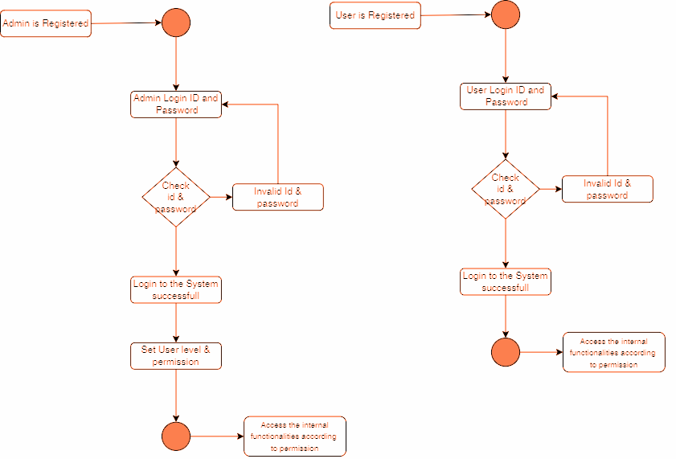
STATE DIAGRAM

Slide 7
Android Interfaces

Slide 8
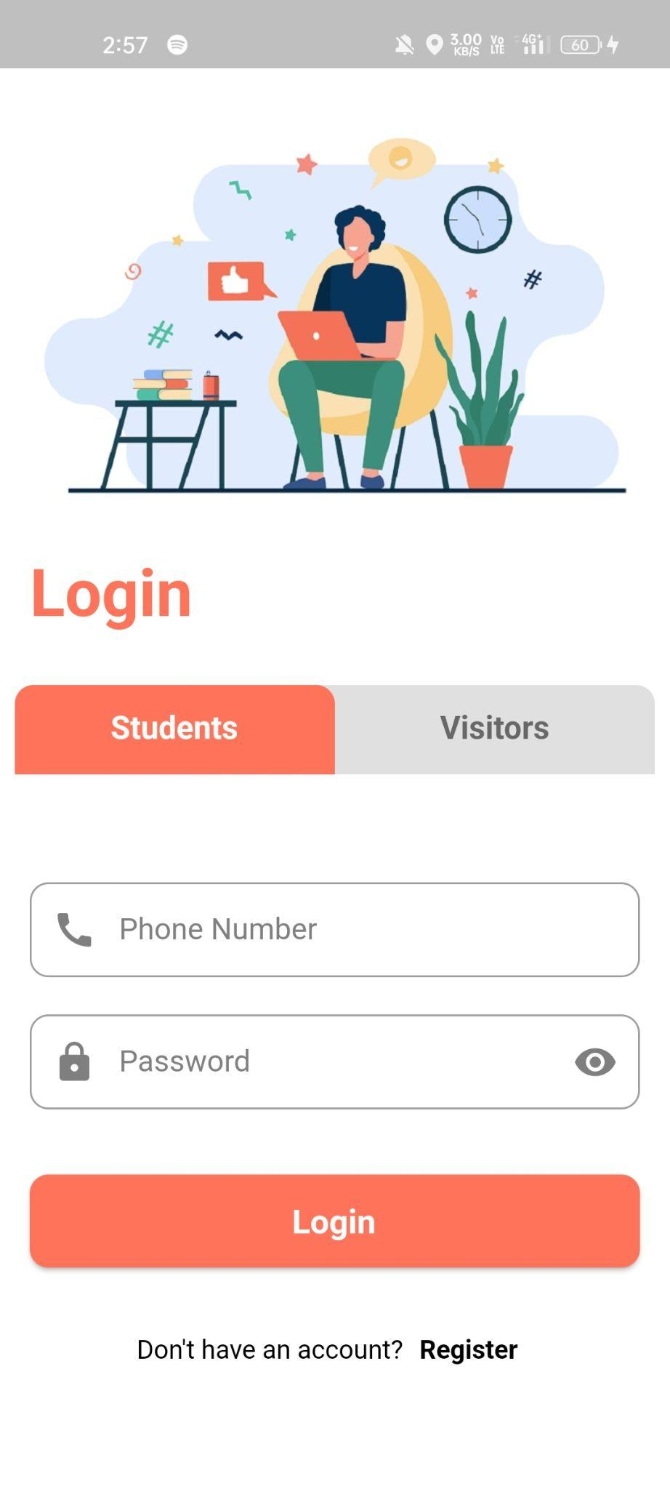
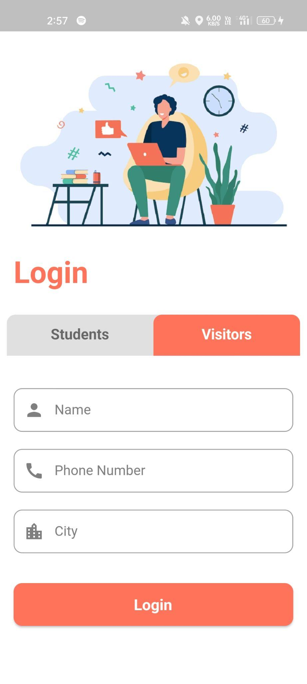
LOGIN SCREEN
Separate tabs for Student and Visitor.
Visitor: Not the student/faculty of our university

Slide 9
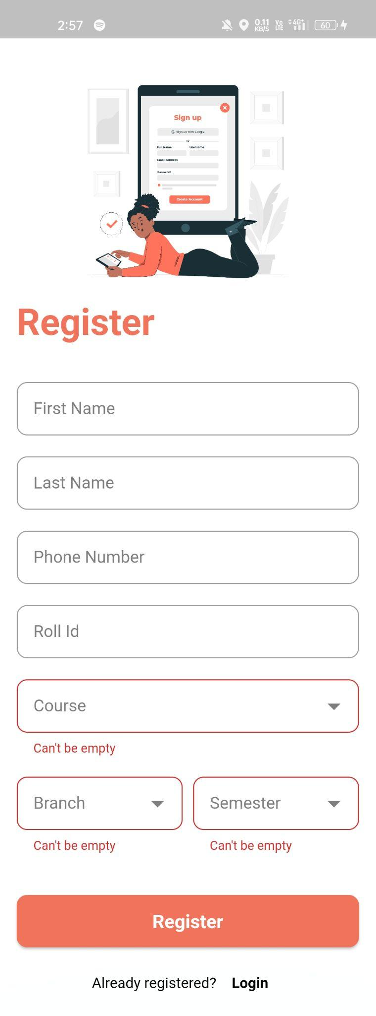
REGISTER SCREEN
Student have to register to use this app.
Visitor don’t need to register.

Slide 10
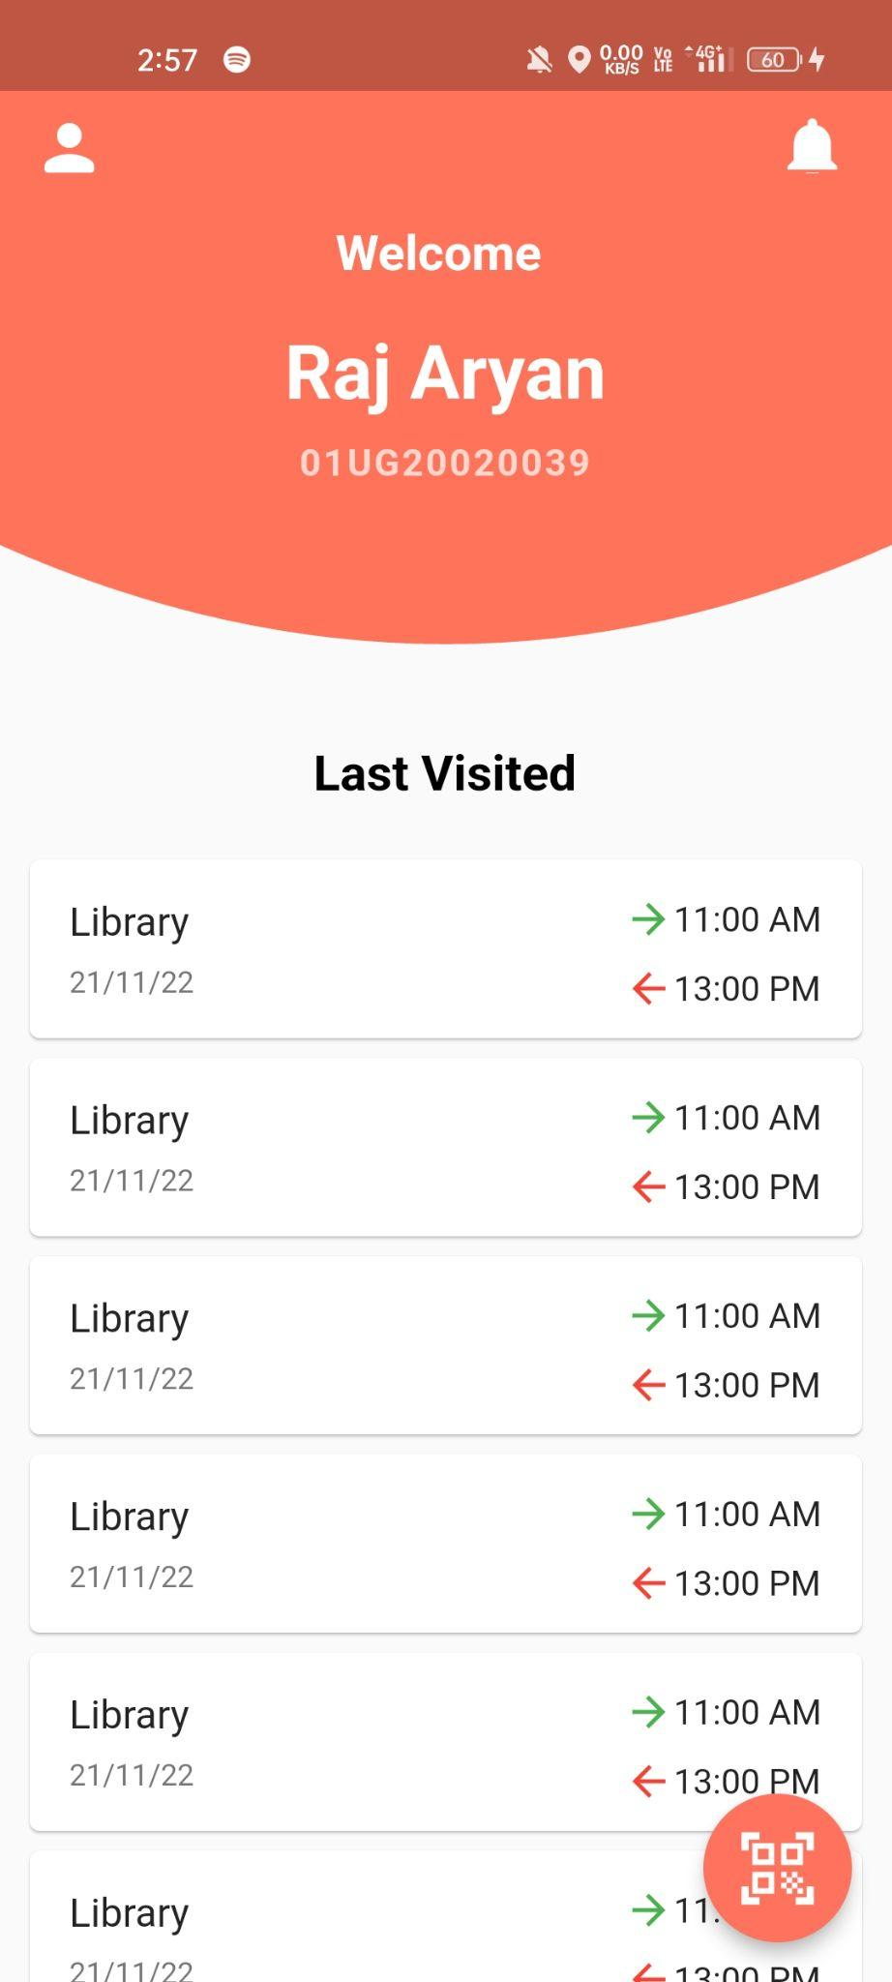
DASHBOARD SCREEN
This is the dashboard where user can see his last visits along with time.

Slide 11
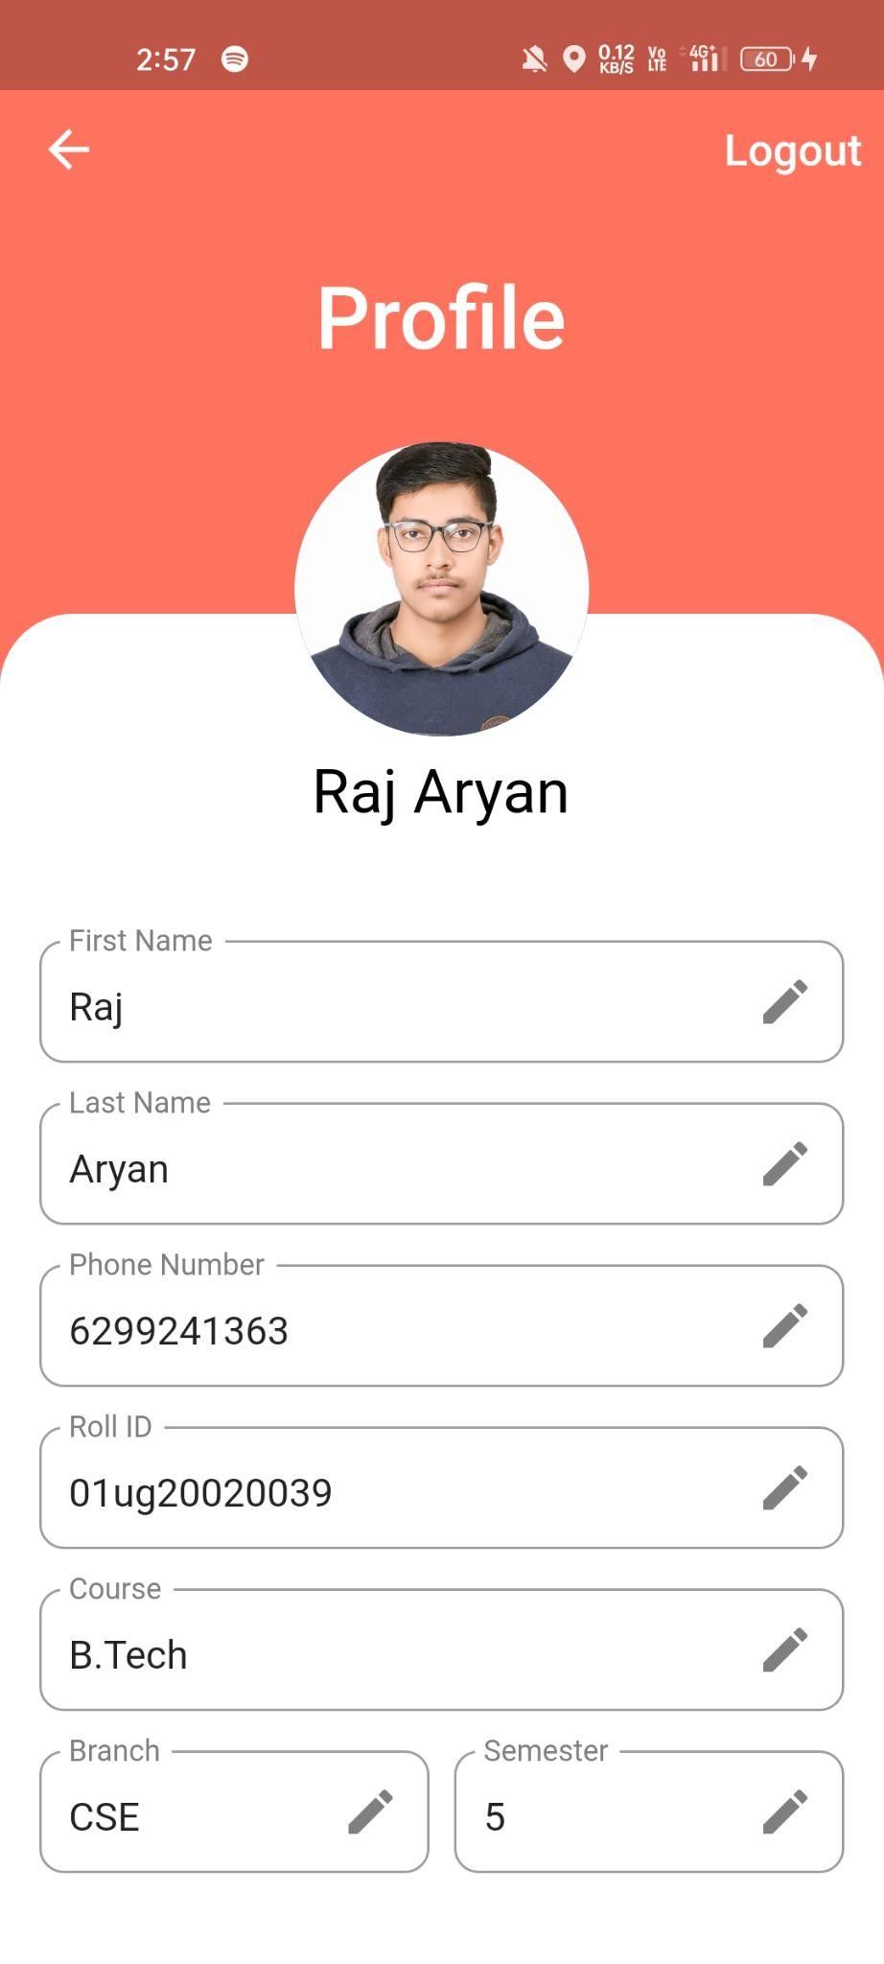
PROFILE SCREEN
It contains the user data. User can edit it.
It also have logout button.

Slide 12
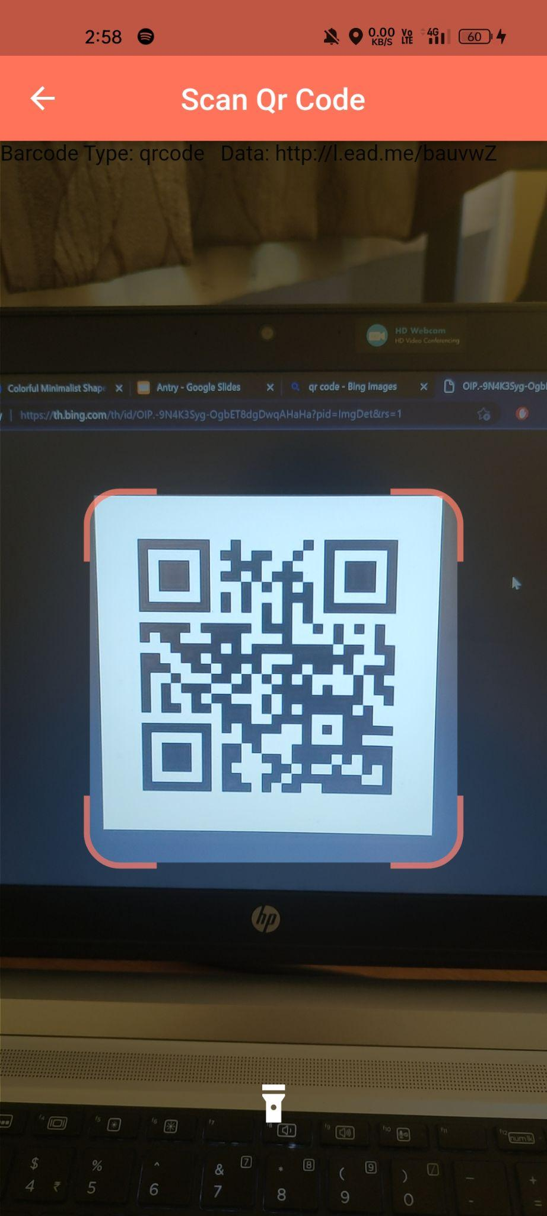
QR SCANNER SCREEN
User have to scan the code to enter the lab or library.
For both, entry and exit, user have to scan the code.

Slide 13
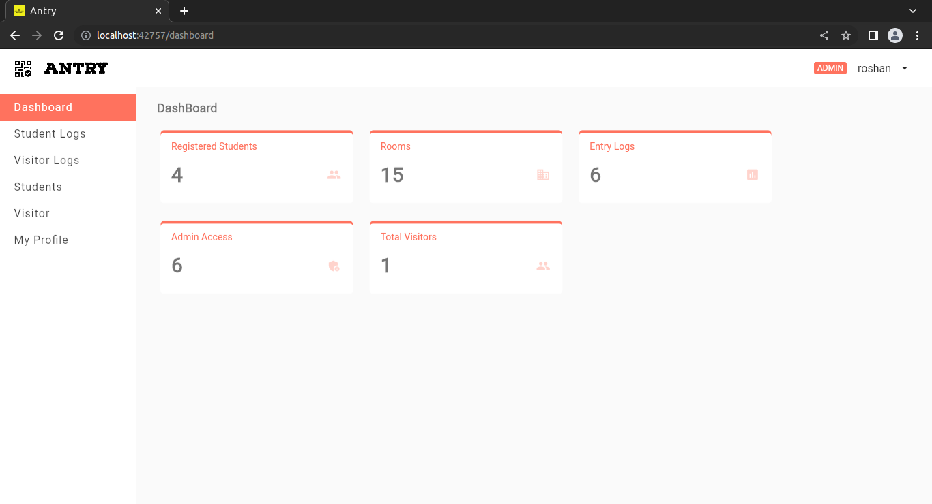
ADMIN WEB INTERFACE
This is the admin web screen, from here, the admin can add rooms, generate code for the room, see students and visitors log.

Slide 14
CONCLUSION
This application can drastically reduce the pen paper work as it can be automated.
It can also help in storing the information in more easy way and can be used to take attendance.
With simple user interface, it will be easy to use and user friendly
Hence this system is capable of doing all such operations with effective results.

Slide 15


Thank you!

